Slide 1
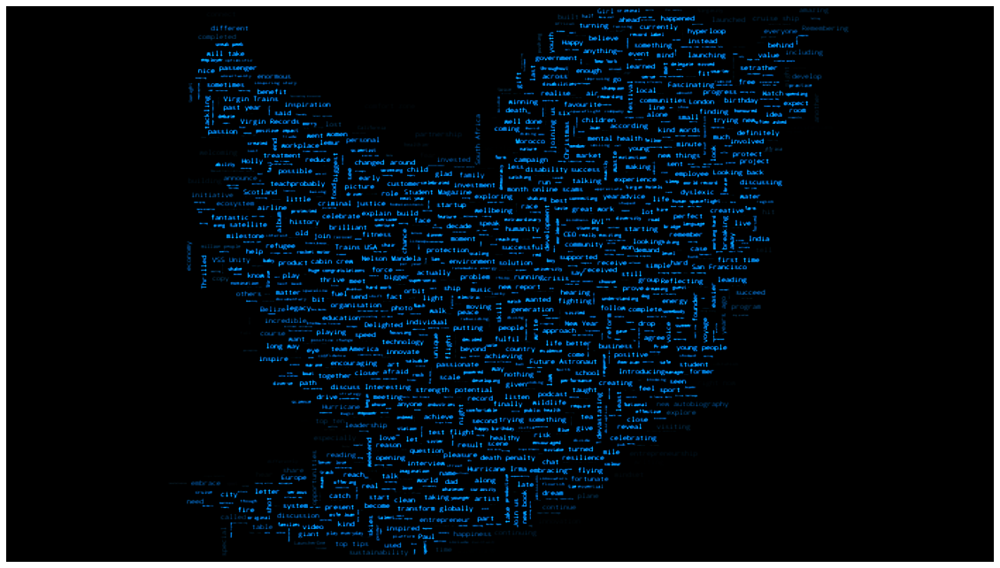
PREDICTING COMPANY STOCK MOVEMENTS WITH EXECUTIVE TWEETS
Tyler Poore
Mentor: Ben Bell
Oct 2020

Slide 2

Introduction:
too high imo…
Shares of Tesla dropped as much as 12% Friday before closing down 10.3% after CEO Elon Musk tweeted that the company’s shares are priced “too high.”
- CNBC
Taking a bird's eye view of the entire situation, one cannot help but speculate that Tesla's C.E.O himself has pushed his company's share price down, after posting a flurry of tweets that shared controversial views on the current lockdowns in place inside the United States.
– Ramish Zafar for WCCFtech
Springboard
Notes:
On May 1st, 2020, at precisely 11:11 am EST, Elon Musk decided to tweet.
\"Tesla stock price is too high imo\".
The share price that was standing at $760 on 11:15 am dropped to the day's low of $702 on 11:40 am, losing roughly 7% of its value within minutes (\\$14B in value)
Earlier in 2018, Elon Musk was charged securities fraud for misleading tweets about potentially taking Tesla private.
The tweet in question: "Am considering taking Tesla private at $420. Funding secured." Resulted in the charges, and a $40M fine, Musk losing his chair at Tesla, and an 11% increase of Tesla's stock price at the day's close.
Nonetheless, until greater federal action is taken, company CEOs are going to continue to tweet their personal thoughts on a variety of topics, including those that may directly impact their company's stock price, which can be really frustrating for investors.

Slide 3

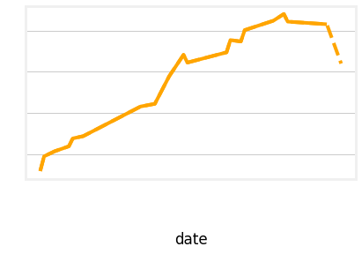
Mobile-App Mock Up
Rapidly determine company stock changes with CEO’s Tweets
Feature Extraction
Feature Engineering
Natural Language Processing
TSLA Stock Price
Predicted Stock Price
Machine Learning
Springboard
Notes:
In response to this, I wanted to see if it was possible to build a model that would make rapid market change predictions by using the Tweets posted by company CEOs. This would serve as a tool for investors that can identify significant, upcoming market changes.

Slide 4
Data Wrangling Collected Data
Data collected using yfinance and twint between August 23rd, 2016 to July 20th, 2021
Executive | Twitter Handle | Company Affiliation | Total Tweets Collected | Company Stock Ticker | Total Market Days Collected
Elon Musk | @elonmusk | CEO and product architect of Tesla, Inc. | 11622 | TSLA | 1259
Aaron Levie | @levie | Co-founder of Enterprise Cloud Software Box | 1736 | BOX | 1259
Jack Dorsey | @jack | CEO of Twitter, Inc. | 5124 | TWTR | 1259
Mark Benioff | @Benioff | Founder, chairman and CEO, Salesforce | 4871 | CRM | 1259
Richard Branson | @richardbranson | Founder of Virgin Galactic | 7711 | SPCE | 981
John Legere | @JohnLegere | Former CEO T-Mobile US (Left April 30, 2020) | 37302 | TMUS | 1259
Springboard
Notes:
A maximum of 5-years of stock data were collected from Yahoo! finance using yfinance. All stocks were collected between August 23rd, 2016 to July 20th, 2021 with the exception of SPCE (Virgin Galactic) where the earliest public stock price is September 29th, 2017.
I obtained Twitter data using Twint for company executives that had at least 1000 tweets within the 5 years of the collected stock prices. The table summarizes the chosen CEOs and their companies.

Slide 5

Data Wrangling Feature Engineering
Features in Tweet
Links
Number of Sentences
Mentions
Number of Words
Hashtags
Avg Words per Sentence
Media
Number of Nouns
spaCy
Number of Verbs
Number of Orgs
There are two stock prices per day (the open and the close) that the tweets can impact. Tweets that occur between these two prices are grouped together into a single row with their summed features and the target return (the change between the price before the tweets, and the price after the tweets).
Springboard
Notes:
.. The number of nouns, verbs, and mentions of an organization like Twitter or Tesla were also counted. The tweets were organized into Pandas DataFrames containing the raw text and the counts for each feature generated from the tweet.
Tweets that fell between the stock open and close prices were grouped together with assumption they would impact the next price point. Stock prices were converted to the percent change between the open and closing prices (the stock's return), and the stock returns were merged with the collected tweets.

Slide 6
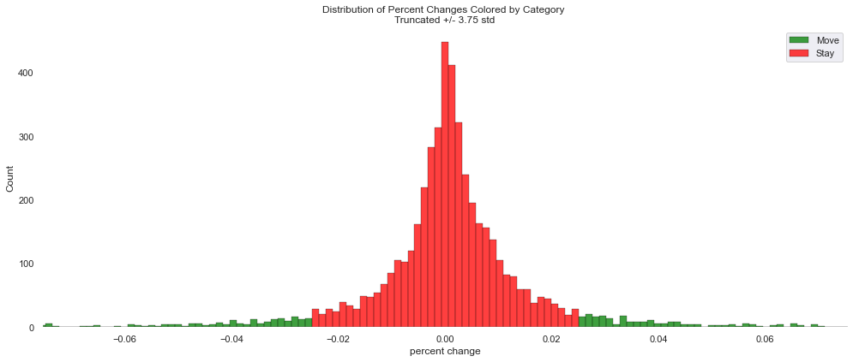
Data Exploration Distributions
Histogram x-axis is truncated by +/- 3.75 std to better display the data
Returns less than 2.5%:
Histogram of Returns: Return counts for each stock movement class
We are trying to predict stock movement through classification, and both the disparity between the two classes (move and stay) and the number of positive samples (move) we can use for prediction will impact our model. Though we would ideally like balanced data, this restricts the variation between the features that we want to capture.
Stays
4515
Counts
Returns greater than 2.5%:
Moves
519
-7.0%
-2.5%
0.0%
2.5%
7.0%
Return
Springboard
Notes:
We are trying to classify stock movement, and so the returns were allocated into two bins, stocks that moved beyond a predetermined value (classified as move in green), and stock changes that were under this value (classified as stay in red).
Picking the cutoff value for our binary classification problem came down to hypothesizing that stock movement will depend on the features in the tweet. (e.g. a higher number of hashtags in a tweet predicts stock price movement).
As I want to capture the largest differences between the distributions of the class features, these differences should be greater between stocks that move only a little, vs stocks that move a lot, assuming the hypothesis is true.
I use a cutoff of 2.5%, which gives a 10:1 imbalance of the majority stay class over the move class.
We can change the bin cutoff for testing purposes, but this was used initially for the purpose of trying to capture the maximum feature differences without creating too imbalanced data.

Slide 7
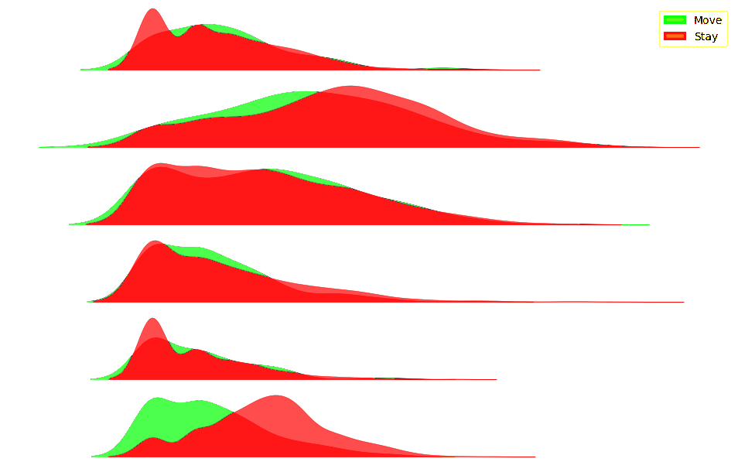
Data Exploration Distributions
Kernel Density Estimation Plots for Number of Tweets
KDE Plots: Number of tweets for each stock movement class
Twitter Handle
Stays
@Benioff
Moves
@JohnLegere
@elonmusk
The Kernel Density Estimation plots show the distributions of tweet counts in stocks that move above the 2.5% return cutoff (depicted in green), and those that fall below the cutoff (depicted in red). Key takeaway is amount of visible green indicates different distributions of the same feature (e.g. @richardbranson).
@jack
@levie
@richardbranson
0
Number of Tweets
4
Springboard
Notes:
Here I Just wanted to show the distributions of the number of tweets in each stock movement class. The takeaway is how much green can be see for each username.
The distribution in the number of tweets varies significantly with each class Richard Branson. Even though there is a large overlap in the binned values, the visible density difference in a lower number of tweets before an open/close price seems to indicate that there is a correlation in this feature and stocks that move beyond the +/- 2.5%.

Slide 8
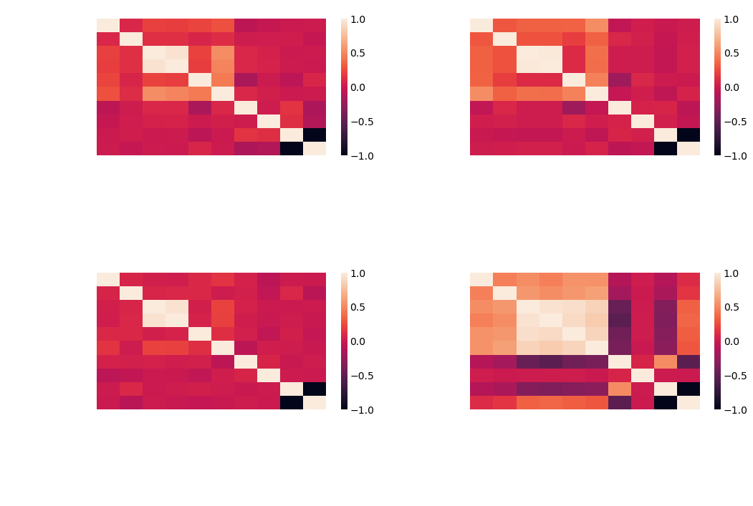
Data Exploration Heatmaps
Strong correlations between the tweet features can be seen for each executive in varying degrees
The heat color corresponds to Pearsons’ r correlation value between each feature
Springboard
Notes:
Heatmaps of the feature correlations for each CEO are below. The bin categories, stay and move, were added as binary features for visualization. The heat color corresponds to Pearsons’ r correlation value between eac
Strong correlations between the tweet features can be seen for each executive in varying degrees.
The percent change values themselves don’t have any strong correlations across any of the scraped tweet features, save for a small positive correlation in Elon Musk’s tweets, but the tweets collected from Richard Branson seem to have some unique correlations that may impart some predictability in our machine learning model.
h feature.

Slide 9
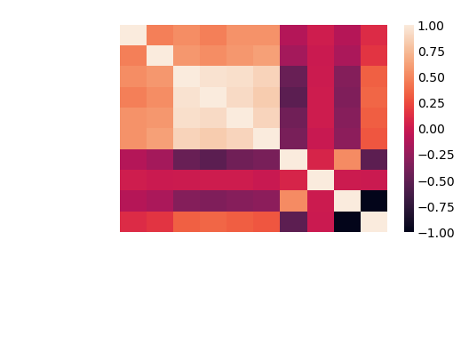
Data Exploration Correlations
1.00
Features
Very strong correlations between Richard Branson’s media features and the number of tweets
0.0
-1.00
The heat color corresponds to Pearsons’ r correlation value between each feature
Springboard
Notes:
There are very strong correlations between Richard Branson’s media features and the number of tweets,. This strong correlation between the features is present to a lesser degree in the other CEO heatmaps….
and bins isn’t present in any of the other CEO heatmaps. It is also interesting that the price and move bins are both negatively correlated with the other features in the dataframe.

Slide 10
Data Exploration Correlations
1.00
Price and move bins are both negatively correlated with the other features in the dataframe
0.0
Target Variables
-1.00
The heat color corresponds to Pearsons’ r correlation value between each feature
Springboard
Notes:
The correlations between the features and the and target variables isn’t present in any of the other CEO heatmaps. It is also interesting that the price and move bins are both negatively correlated with the other features in the dataframe. The features seem to be slightly positively correlated with stocks that don’t move and more negatively correlated with stocks that do.

Slide 11
Model Testing
Average Scores Across Five Cross Validations
Positive Label: Move
Username | Estimator | Mean ROC_AUC Score | Number of Samples | Number of Samples in MOVE
richardbranson | SVC | 0.812813 | 662 | 75
levie | SVC | 0.556709 | 311 | 40
jack | LogisticRegression | 0.527795 | 373 | 60
elonmusk | LogisticRegression | 0.511213 | 421 | 81
JohnLegere | MultinomialNB | 0.566458 | 1106 | 45
Benioff | LogisticRegression | 0.694064 | 647 | 61
Springboard
Notes:
I elected to use Richard Branson to tune and evaluate the model for the following reasons.
Because Richard Branson demonstrated some interesting results during the EDA,
has the highest AUC and recall scores, second highest precision score
Has a large sample size for the positive minority class

Slide 12
Model Results
Confusion Matrix and Classification Report Following Model Optimization
Model: SVC({'C': 10.0, 'gamma': 0.01, kernel=‘rbf’ class_weight=‘balanced})
PREDICTED
Stay
Move
 | Precision | Recall | F1-score | Support
CLASS
Stay | 89% | 77% | 82% | 295
Move | 54% | 75% | 62% | 107
Threshold |  |  |  | 0.21
Accuracy |  |  | 76% | 402
Macro Avg | 72% | 76% | 72% | 402
Weighted Avg | 80% | 76% | 77% | 402
Move
Stay
ACTUAL
Springboard

Slide 13
Model Results
Confusion Matrix and Classification Report Following Model Optimization
Precision: Total Class Predictions that Are Correct (Stay)
Model: SVC({'C': 10.0, 'gamma': 0.01, kernel=‘rbf’ class_weight=‘balanced})
PREDICTED
Stay
Move
 | Precision | Recall | F1-score | Support
CLASS
Stay | 89% | 77% | 82% | 295
Move | 54% | 75% | 62% | 107
Threshold |  |  |  | 0.21
Accuracy |  |  | 76% | 402
Macro Avg | 72% | 76% | 72% | 402
Weighted Avg | 80% | 76% | 77% | 402
Move
Stay
ACTUAL
Springboard

Slide 14
Model Results
Confusion Matrix and Classification Report Following Model Optimization
Precision: Total Class Predictions that Are Correct (Move)
Model: SVC({'C': 10.0, 'gamma': 0.01, kernel=‘rbf’ class_weight=‘balanced})
PREDICTED
Stay
Move
Need to increase precision
 | Precision | Recall | F1-score | Support
CLASS
Stay | 89% | 77% | 82% | 295
Move | 54% | 75% | 62% | 107
Threshold |  |  |  | 0.21
Accuracy |  |  | 76% | 402
Macro Avg | 72% | 76% | 72% | 402
Weighted Avg | 80% | 76% | 77% | 402
Move
Stay
ACTUAL
By changing threshold
Springboard

Slide 15
Model Precisions, Recalls vs Thresholds
Thresholds vs Precision Scores
Precision: 0.54
Thresholds vs Recall Scores
Current Threshold, Precision
Threshold: 0.209
Changing the threshold values (x-axis) will result in different recall and precision scores. As can be seen in the Make a Positive Impression with this Clean and Strong Powerpoint Template. With BARA you have everything you need for a powerfull and convincing presentation. This Powerpoint Template is charged with tons of elements, layouts, maps, infographics, charts editable in excel and vector icons.
Precision: 0.69
Threshold: 0.391
Springboard

Slide 16
Model Results
Changes in Scores Over Last Threshold (0.21):
Model: SVC({'C': 10.0, 'gamma': 0.01, kernel=‘rbf’ class_weight=‘balanced})
SCORE IMPROVED
SCORE DECREASED
PREDICTED
Stay
Move
 | Precision | Recall | F1-score | Support
CLASS
Stay | 89% | 77% | 82% | 295
Move | 54% | 75% | 62% | 107
Accuracy |  |  | 76% | 402
Macro Avg | 72% | 76% | 72% | 402
Weighted Avg | 80% | 76% | 77% | 402
 | Precision | Recall | F1-score | Support
CLASS
Stay | 84% | 92% | 88% | 295
Move | 69% | 50% | 58% | 107
Accuracy |  |  | 81% | 402
Macro Avg | 76% | 71% | 73% | 402
Weighted Avg | 80% | 81% | 80% | 402
 | Precision | Recall | F1-score | Support
CLASS
Stay | 84% | 92% | 88% | 295
Move | 69% | 50% | 58% | 107
Threshold |  |  |  | 0.39
Accuracy |  |  | 81% | 402
Macro Avg | 76% | 71% | 73% | 402
Weighted Avg | 80% | 81% | 80% | 402
Move
Stay
ACTUAL
Springboard

Slide 17
@richardbranson Posts Before Market Close
July 12th, 2021
Stock Open (Before Tweet): $49.55
Model Predicts MOVE with 64.47% Certainty
Stock Close (After Tweet): $40.69
Return -17%
”Virgin Galactic falls 17% after it gets set to sell $500 million in stock following Branson’s successful flight."
Springboard

Slide 18
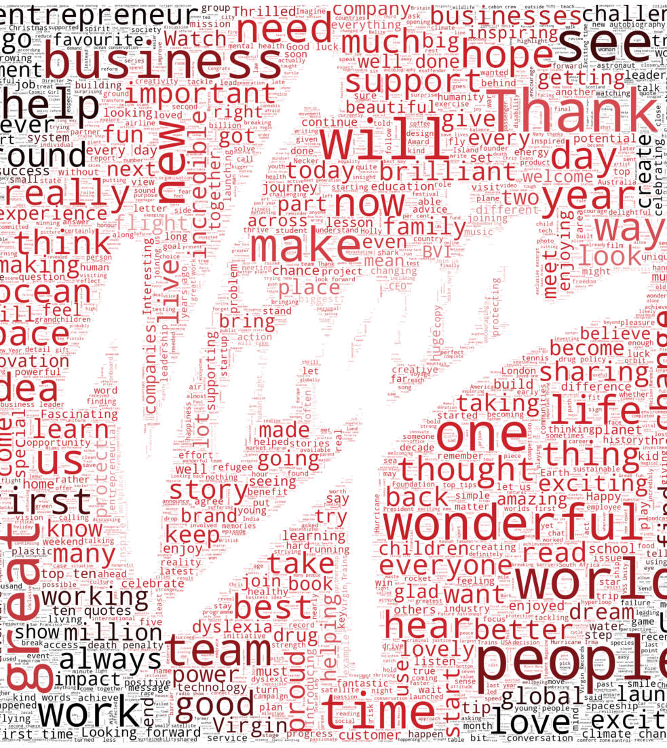
Conclusions
A Company’s Stock Movements Can Be Reasonably Predicted Using Their Executive’s Tweets
The Predictive Power is Heavily Reliant on the Individual Tweeting
Can be used as a Tool for Investors to Forecast Stock Movement and Aid in Due Diligence for Investment Strategies
Springboard

Slide 19
Future Work
Predict Positive and Negative Stock Movements
Use Word Embedding to Better Capture Text Information
Scale the Model to Capture More Twitter Data and Do Real-Time Analysis
Springboard

Slide 20
Sources
BBC Elon Musk tweet wipes $14bn off Tesla's value
SEC: Elon Musk Charged With Securities Fraud for Misleading Tweets
NYT: Elon Musk Says Tesla May Go Private, and Its Stock Soars
CNBC: Elon Musk's tweets are moving markets — and some investors are worried
YouTube: How To Use Twitter For Trading
CNBC: Virgin Galactic falls 17% after it gets set to sell $500 million in stock following Branson's successful flight
Springboard

